Slide 1

Access Your Required Course Materials
Registering for Connect® through D2L
BCIT

Slide 2

How to Register
Go to your instructor’s D2L BrightSpace course and click on the “Content” tab.
In the search bar on the left, type “Connect”.
From the search results, select the “McGraw Hill Connect” external learning tool.
Click “Begin”
Enter your student email and click “BEGIN”.
If you already have a Connect account, enter your password.
If you do not have a Connect account, complete the form, and click “CONTINUE”.
Enter your 20-Digit Connect Access Code. Buy your Access code from Bookstore or start a two-week temporary access.
Confirm your access to the course material
Congratulations! You have now registered your Connect access. You can click “GO TO CONNECT” to access the resources directly.

Slide 3
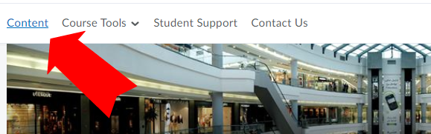
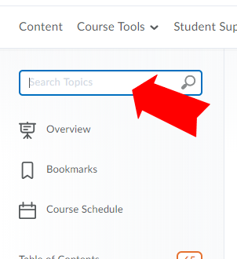
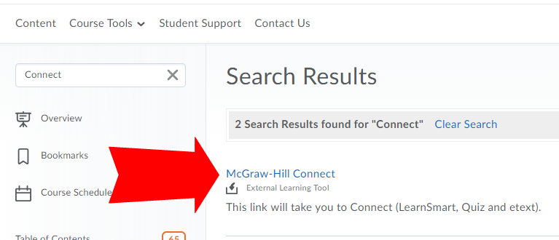
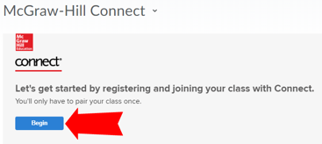
Getting Started
D2L
1.Go to your instructor’s D2L BrightSpace course and click on the “Content” tab.
2. In the search bar on the left, type “Connect”.
3. From the search results, select the “McGraw-Hill Connect” external learning tool.
4. Click “Begin”

Slide 4
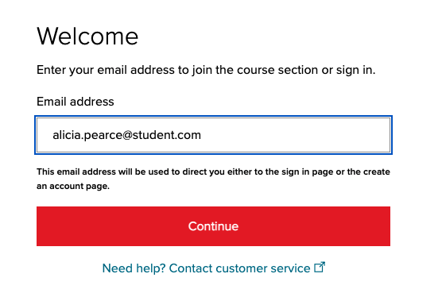
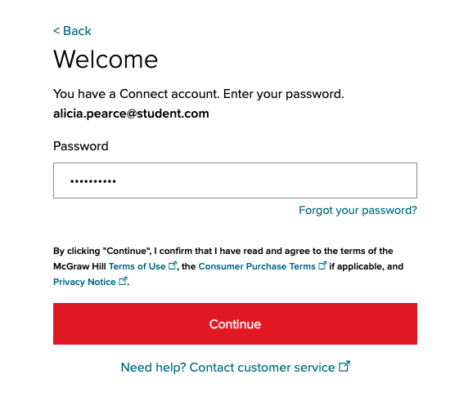
How to Register – Existing Account
D2L
5. Enter your student email and click “BEGIN”.
6. If you already have a Connect account, enter your password.

Slide 5
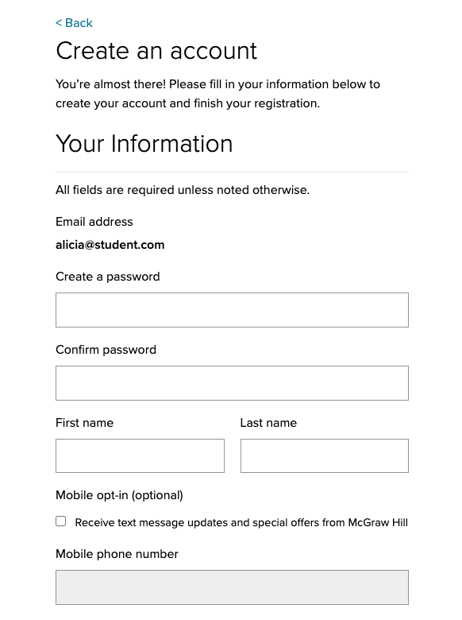
How to Register – New Account
D2L
4. Enter your student email and click “BEGIN”.
5. If you do not have a Connect account, complete the form, and click “CONTINUE”.

Slide 6
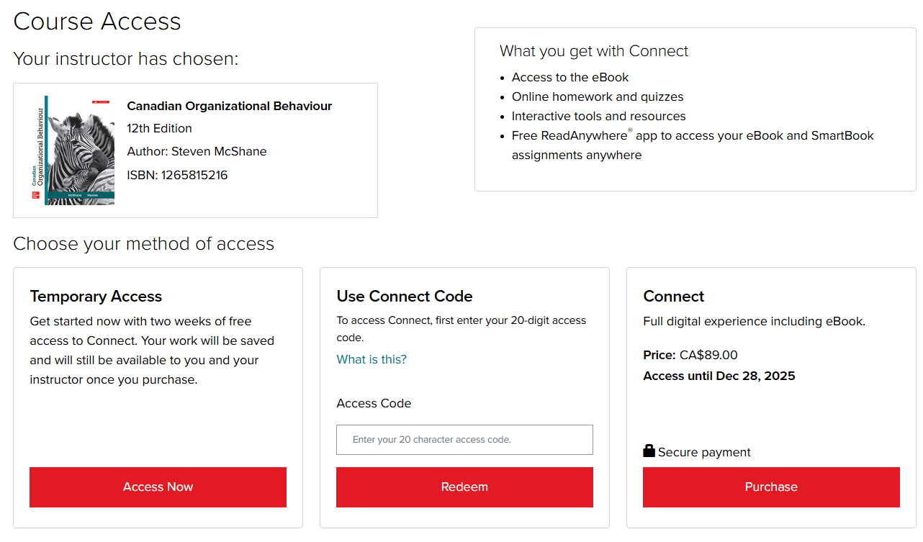
How to Register – Purchase Options
D2L
7. Enter your 20-Digit Connect access code, Buy your access code Online, or start a two-week temporary access.

Slide 7
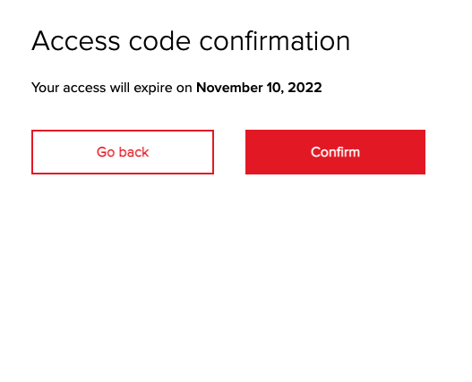
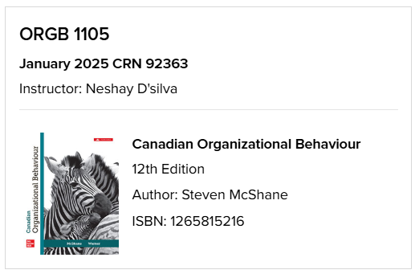
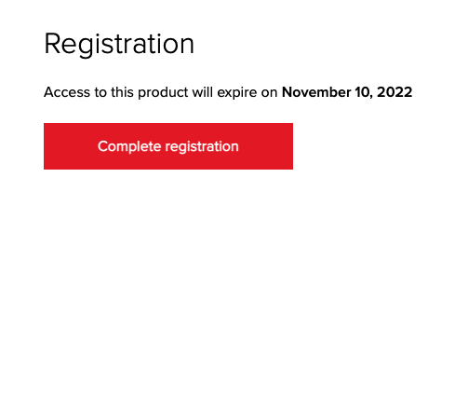
How to Register – Final Steps
D2L
January 5, 2024
8. Confirm your access to the course material
January 5, 2024
9. Click complete registration.

Slide 8

Purchase Options
McGraw Hill offers a variety of purchase options so you can choose the flexible course materials that suit your learning style.
Connect Online Access
Print + Connect Package
Available at:
Bookstore: $99.95
Receive instant access to your eBook, homework and adaptive assignments, and study resources.
Available at:
Bookstore: $171.95
You will receive a Connect access card, plus colour, print bound version of the complete text.
McGraw Hill | Making the Most of Your Course Tools
8

Slide 9
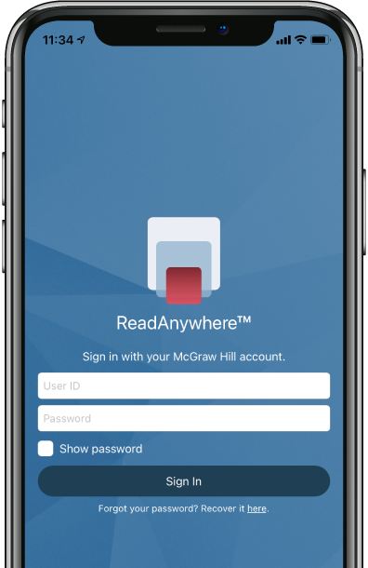


ReadAnywhere App
The FREE ReadAnywhere App makes it easy to read your Connect eBook on your smartphone or tablet so you can study anywhere, anytime.
Complete SmartBook assignments
Listen to your textbook with audio functionality
Sync assignments & notes
Download & read chapters
Work online or offline
Highlight and take notes
Download Now

Slide 10
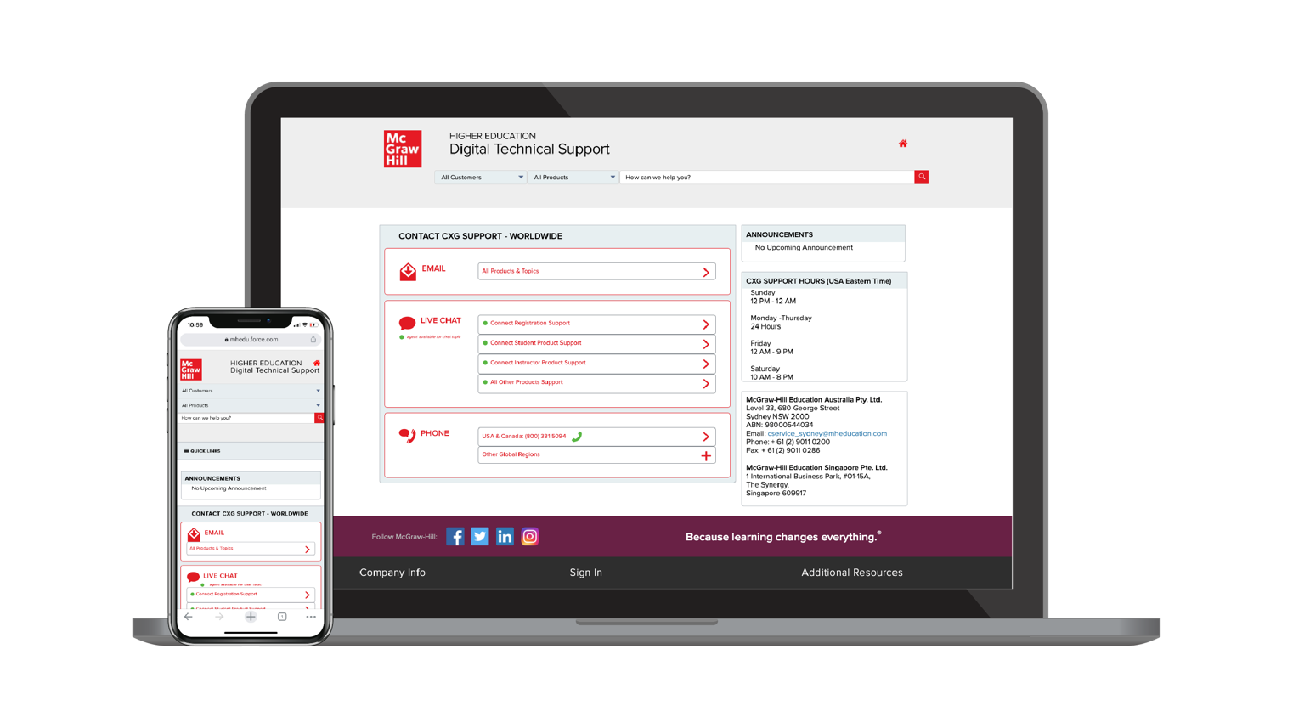
Accessibility & Support
MyCanvas
Accessibility
Support Hours (ET)
If you have any questions or concerns about interacting with our products, please contact your institution’s Accessibility Office.
Sunday
12 PM – 12 AM
Monday - Thursday
24 Hours
Friday
12 AM – 9 PM
Saturday
10 AM – 8 PM
Support
We’re here to help. If you need technical help with Connect, get in touch with our experts:
Phone: (800) 331 5094 (USA & Canada)
Web: Get in touch

